Slide 1
Is Something on Fire? Using Prometheus to Monitor System and Application Health
Albert Holtsclaw

Slide 2
Notes:
I want to walk through some housekeeping to ensure everyone gets the most out of today’s learning session.
All participants are automatically muted to cut down on background noise
Please type any questions using the Q&A feature of the webinar toolbar
Live transcript is enabled and located in the webinar toolbar if you would like to turn on closed captioning.
The presentation will be recorded and will be available to attendees for 30 days on the SIGConnect website

Slide 3
Albert Holtsclaw
Senior Consultant
holtsclaw@sigcorp.com
DBA / DevOps wrangler of Ellucian's Banner ERP system and ancillary products and services for clients on-premise and in the cloud.

Slide 4
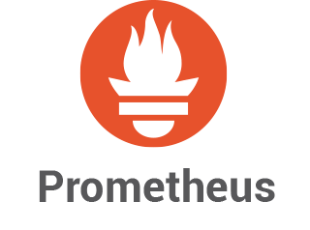
Prometheus Stack Overview
Metrics-based monitoring, alerting, and visualization with:
Prometheus
Alert Manager
Grafana

Slide 5
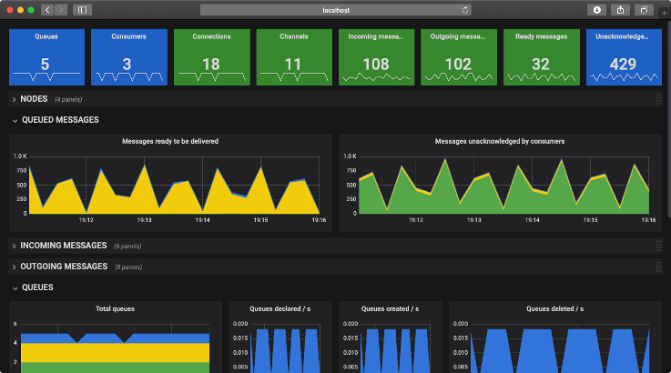
Components
Prometheus
SoundCloud tool. Second “Cloud Native Computing Foundation” graduated project, after Kubernetes
Uses agents (exporters) to expose metrics for Prometheus
Prometheus collects (scrapes) metrics from exporters and stores data for use
Ad-hoc “search” / filter and graph metrics collected by metric names and tags for analysis.
PromQL: Query data similarly to Elasticsearch/Lucene, Kibana, Splunk with simplified language.
Alert Manager
Add-on component for Prometheus to allow Prometheus metrics to dispatch alerts.
Supports various notification targets: email, PagerDuty, Slack, etc.
Grafana
Analytics and visualization system
Build dashboards from a myriad of data sources
(including Prometheus, Cloudwatch, RDBMS, etc.)
Notes:
Prometheus. Where did it come from. What is its Pedigree

Slide 6
Prometheus: Architecture
App Server 1
Database Server
Node Exporter: 9100
Node Exporter: 9100
Tomcat Exporter: 9156
Prometheus
OraDB Exporter: 9161
App Server 2
Batch Server
Node Exporter: 9100
Node Exporter: 9100
JMX Exporter: 9404
Process Exporter: 9256
https://github.com/prometheus/prometheus/wiki/Default-port-allocations

Slide 7
Prometheus: Federation Topology
Prometheus Federation Primary
App Server 1
Database Server
App Server 1
Database Server
/federate
/federate
Node Exporter: 9100
Node Exporter: 9100
Node Exporter: 9100
Node Exporter: 9100
Tomcat Exporter: 9156
Prometheus ENV 1
OraDB Exporter: 9161
Tomcat Exporter: 9156
Prometheus ENV 2
OraDB Exporter: 9161
App Server 2
Batch Server
App Server 2
Batch Server
Node Exporter: 9100
Node Exporter: 9100
Node Exporter: 9100
Node Exporter: 9100
JMX Exporter: 9404
Process Exporter: 9256
JMX Exporter: 9404
Process Exporter: 9256
https://prometheus.io/docs/prometheus/latest/federation/

Slide 8
Exporters
Node (host)
MS SQL
MySql
Oracle
Postgres
Redis
Memcached
RabbitMQ
Kafka
BIG-IP / F5
Apache
HAProxy
Nginx
Varnish
AWS
Azure
Cloudflare
Digital Ocean
Rancher
Github
Jira
https://prometheus.io/docs/instrumenting/exporters/

Slide 9
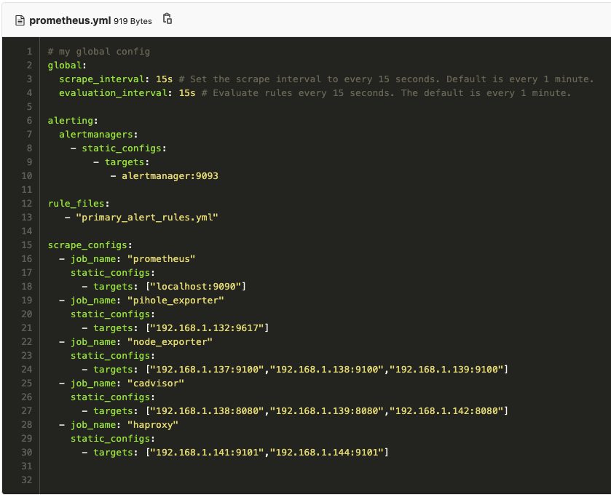
Prometheus: Scrape Configuration

Slide 10
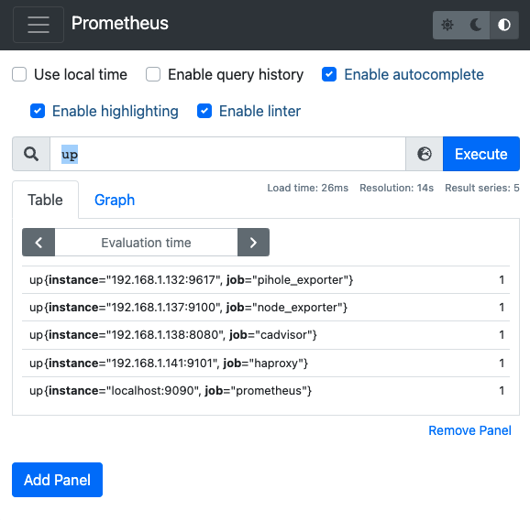
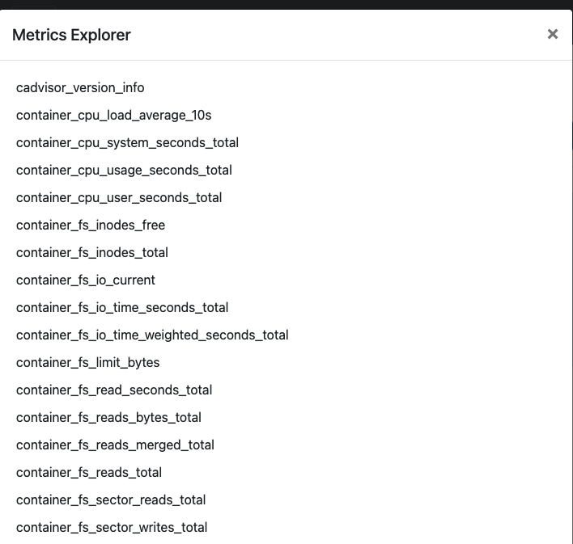
Prometheus: PromQL Ad-Hoc Query

Slide 11
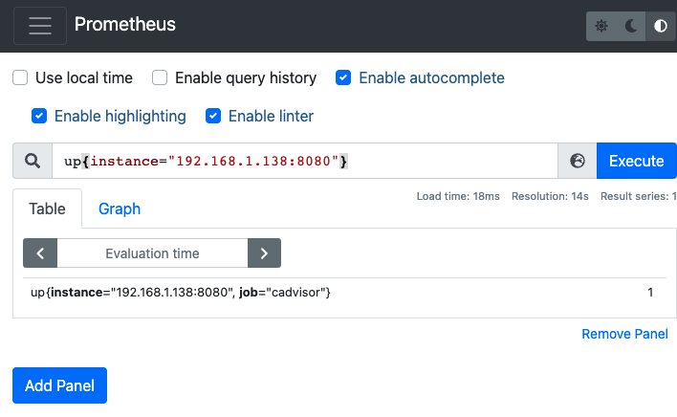
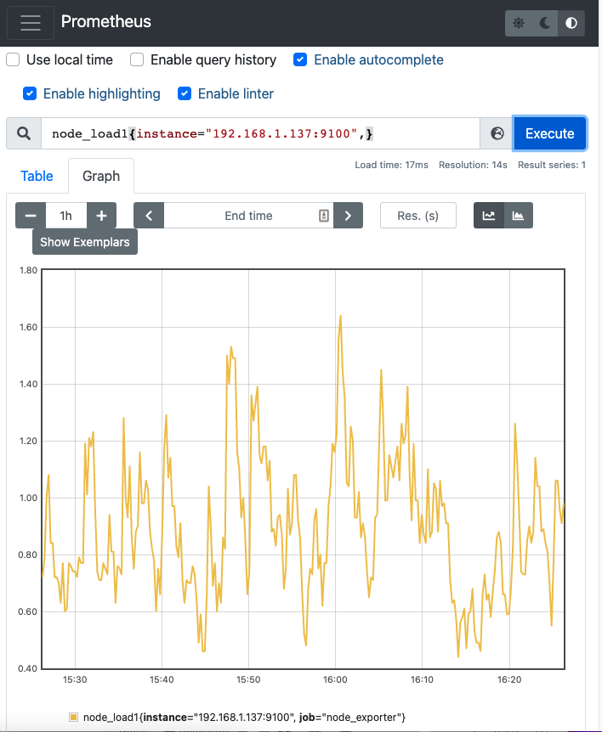
Prometheus: Filtering / Graphing

Slide 12
Alert Rules

Slide 13
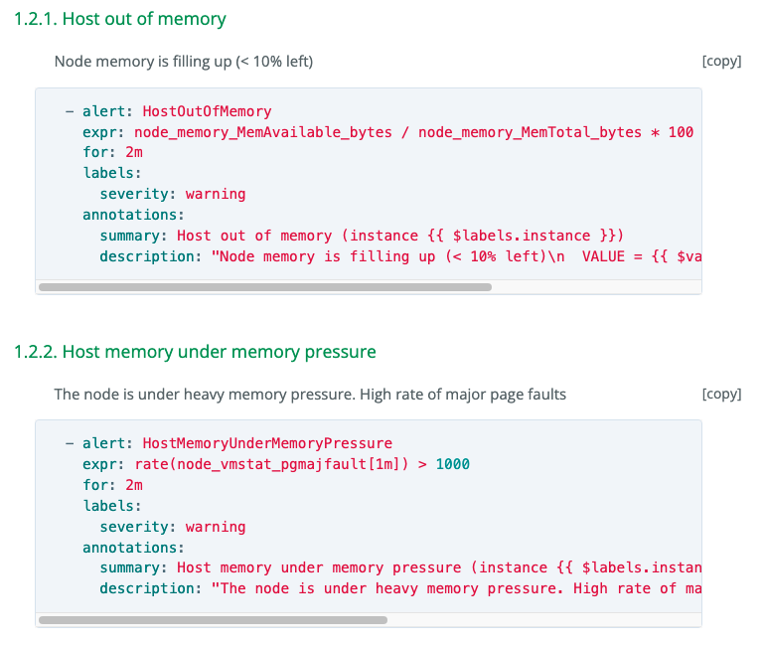
Alert Rules: Community Support
https://awesome-prometheus-alerts.grep.to/rules.html

Slide 14
Alert Manager: Routes and Receivers
Default Route
Default Receiver (email / Slack, etc)
“notif default”
Child Route 1 “prod”
Child Route 2 “non-prod critical”
Receiver “PROD” to Pager
Receiver “Non-Prod Critial” to Slack
Match 'env'=>'production'
Match 'env'=>'non-prod-critical'
It then traverses the child nodes. If continue is set to false, it stops after the first matching child.
If continue is true on a matching node, the alert will continue matching against subsequent siblings.

Slide 15
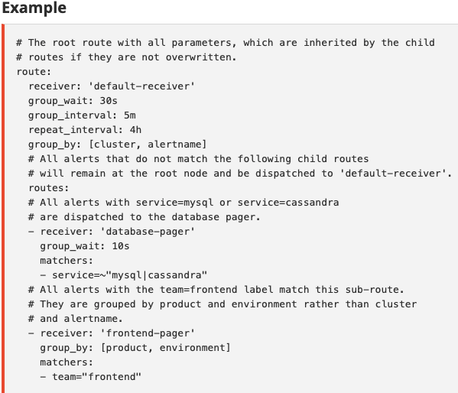
Alert Manager: Example Routes

Slide 16
Alert Manager: Receivers
Email
PagerDuty
Slack
WeChat
Pushover
Opsgenie
VictorOps / Splunk On-Call
Webhook
MS Teams
Etc.
And more

Slide 17
Alert Manager: 3rd-party Integrations

Slide 18
Grafana: Dashboards
RabbitMQ Native Metrics and Dashboard
https://rabbitmq.com/prometheus.html

Slide 19
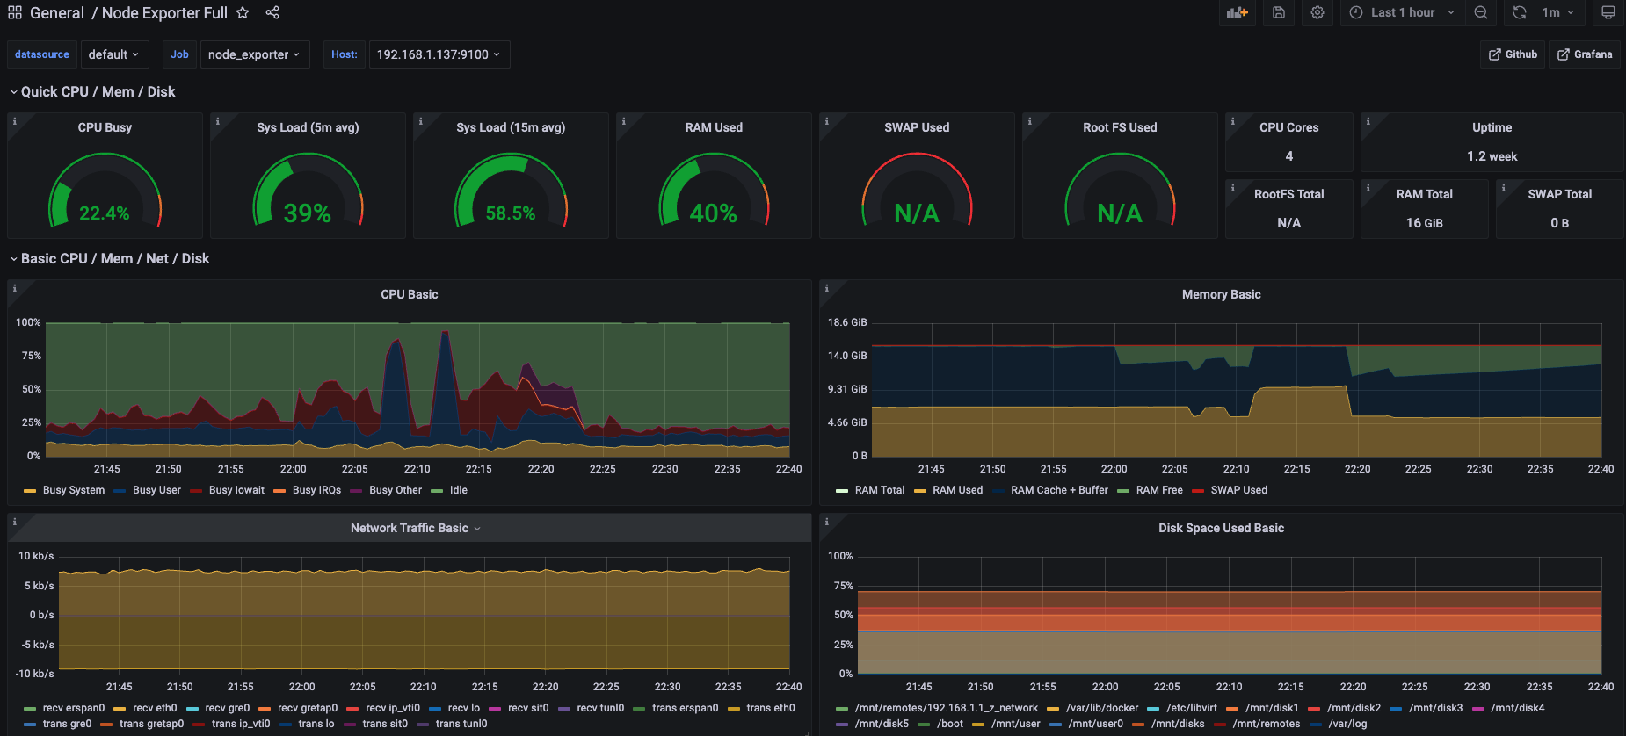
Grafana: Node Exporter

Slide 20
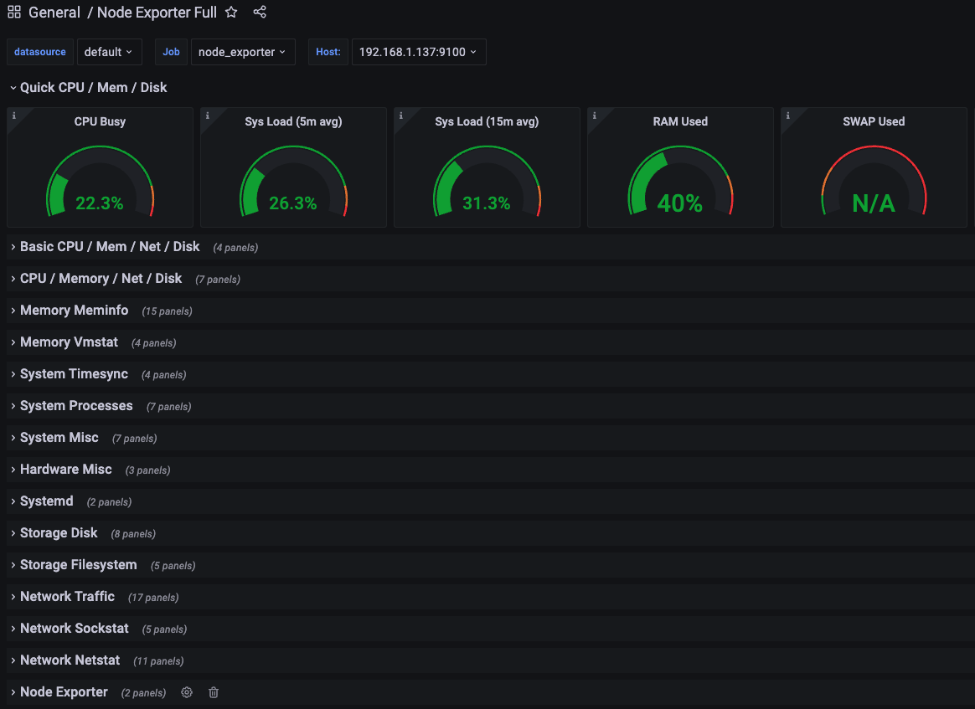
Grafana: Node Exporter

Slide 21
Grafana: Filtering / Time Series

Slide 22
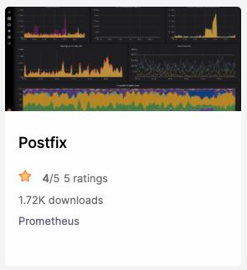
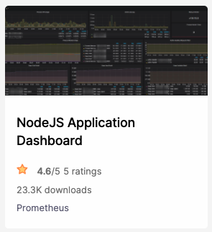
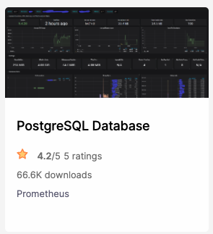
Grafana: Community Dashboards
https://grafana.com/grafana/dashboards/

Slide 23
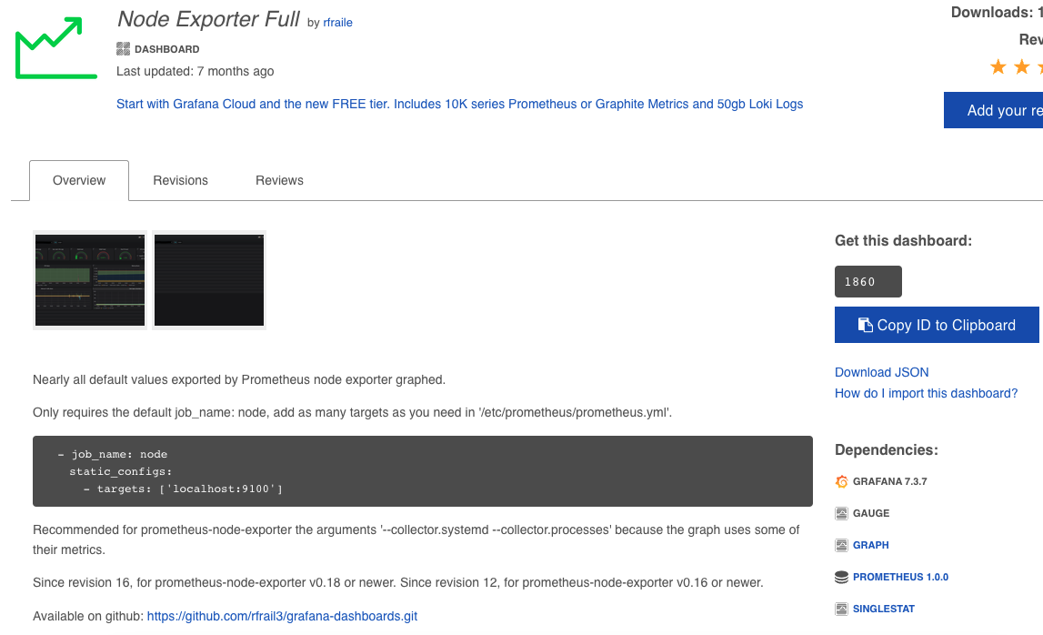
Grafana: Community Dashboards

Slide 24
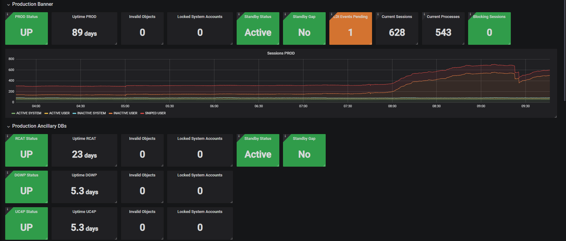
Grafana: Custom Dashboards

Slide 25
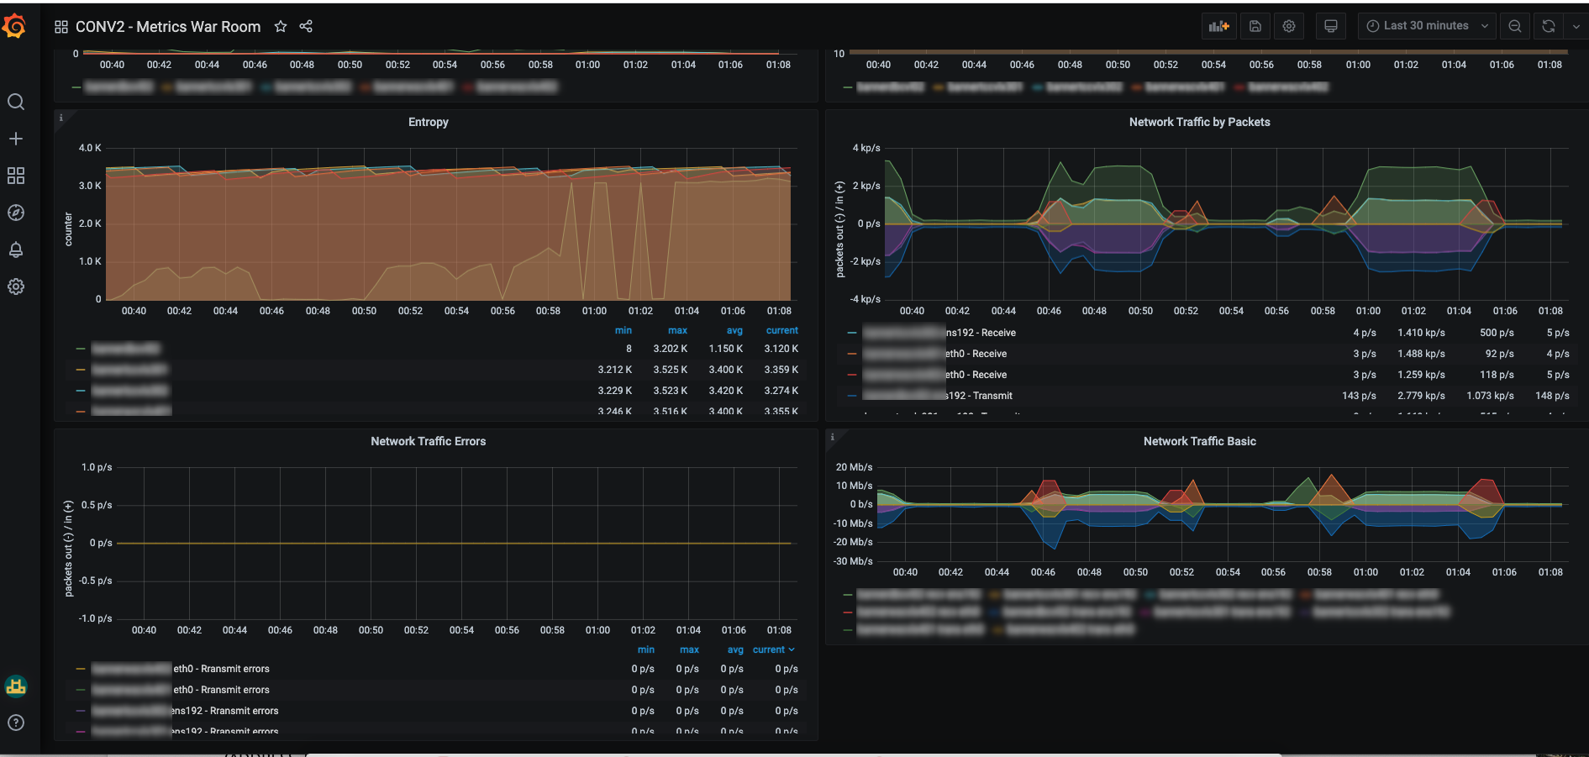
Grafana: Custom Dashboards

Slide 26
Closing Thoughts: Gain Visibility, Improve Response, Get Creative, Costs

Slide 27
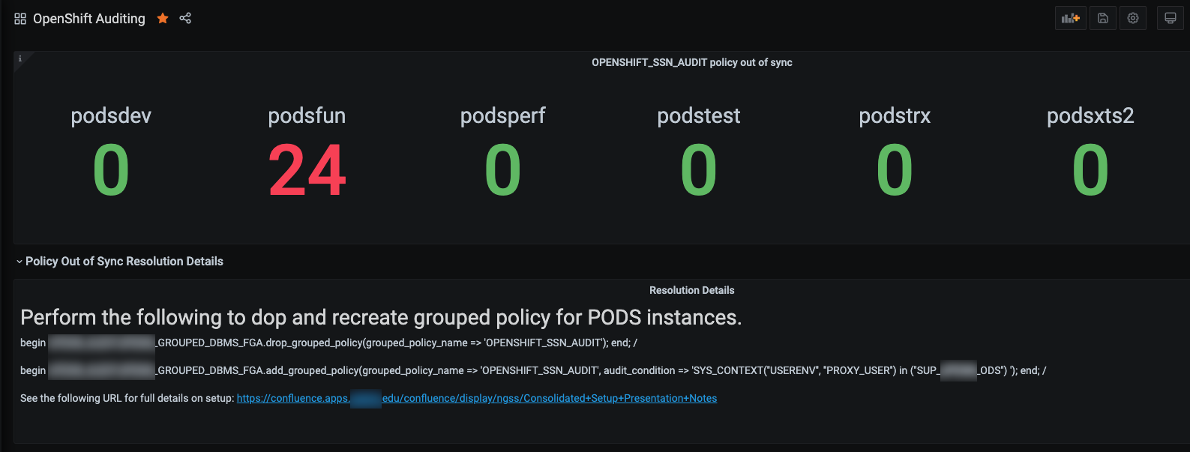
Track Issues, Document Resolutions
Get Alert
Determine Scope
Take Action

Slide 28
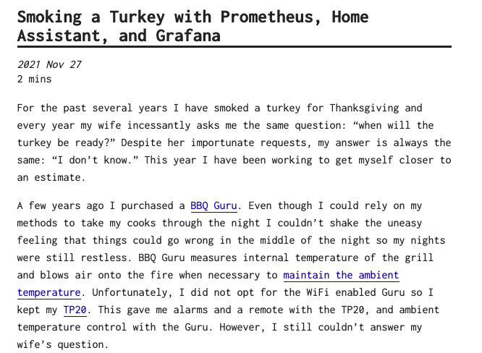
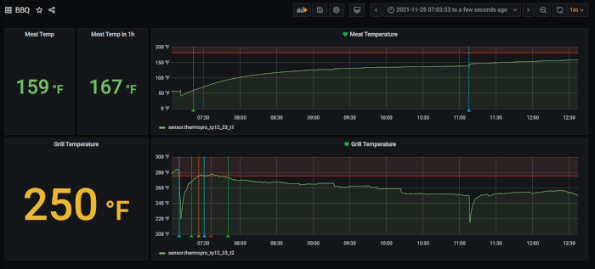
Use Your Imagination
https://www.blockloop.io/smoking-a-turkey-with-prometheus-home-assistant-and-grafana/

Slide 29
Saving the Best for Last
Free and Open Source
https://prometheus.io/
Low Maintenance Overhead
Minimal configuration: prometheus.yml, alert-rules.yml, alertmanger.yml, Grafana dashboards
Great community support and community-built rules/dashboards
No separate database engine - data stored in disk-based time series DB (TSDB)
Lightweight: Prometheus and exporters are self-contained binaries, easy updates
Often bundled into other projects for specific use: Gitlab, OpenShift
Low barrier to entry. Build, expand and scale as needed

Slide 31
Albert Holtsclaw
Senior Consultant
holtsclaw@sigcorp.com

