Slide 1
Moving Banner to AWS:
A Technical Deep Dive
Tennessee Higher Education Information Technology Symposium (THEITS)
April 15th 2019 Track 3, Room A-3 - Session 5.3
Albert ‘Alby’ Holtsclaw Senior Database Administrator / Senior DevOps Architect

Slide 2
Goals and Overview
Motivation
Architecture
Processes, Technologies, and Services Used
Benefits Gained and Challenges Encountered

Slide 3
Motivations
Information Systems, custom applications
Facing Upgrades: SQL Server, Windows Server, Codebase (Accessibility, Framework)
Growing number of “mission critical” applications
Aging Banner ERP Infrastructure
ERP Hosts: RHEL 5, Hardware Replacement, Datacenter Migration (2017)
Availability, Scalability, Disaster Recovery / BC
2015 IT Forum. Dr. Brian Noland, President
Growing Infrastructure Needs / Banner 9
Need for higher efficiency, easier maintenance
Puppet / Configuration Management wasn’t enough
Notes:
Challenged by the President. February 2015
Growing Infrastructure Needs / Banner 9

Slide 4
Architecture
VPC Setup: dev vs prod, subnets, multi-AZ
Databases:
Oracle on EC2 (Unable to leverage RDS, filesystem access, one-off patches)
SQL Server Cluster on RDS, MySQL on Aurora RDS
Job Submission: EC2 (Docker in future?)
All Banner 9 Apps, SSB, Others: Docker / ECS Cluster
eInvoice / IFEP / Old Middleware: EC2 (for now)
Elastic Load Balancers / Application Load Balancers
ETL / Data Integration / Scheduled Tasks: AWS Lambda

Slide 5
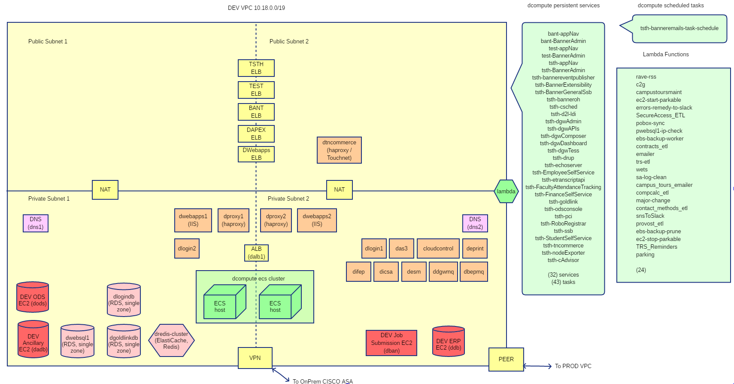
Architecture
Dev VPC

Slide 6
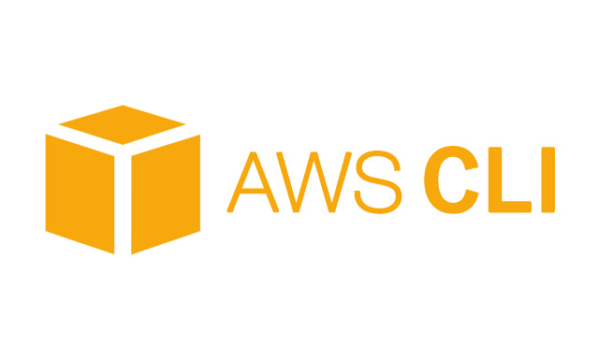
Architecture
https://banner.infosys.etsu.edu/applicationNavigator
Elastic Load Balancer
Public
haproxy1
haproxy2
Private
Other On-Prem
Other EC2
App. Load Balancer
ECS Compute Cluster
Jobsub EC2
Banner Oracle EC2

Slide 7
Architecture

Slide 8
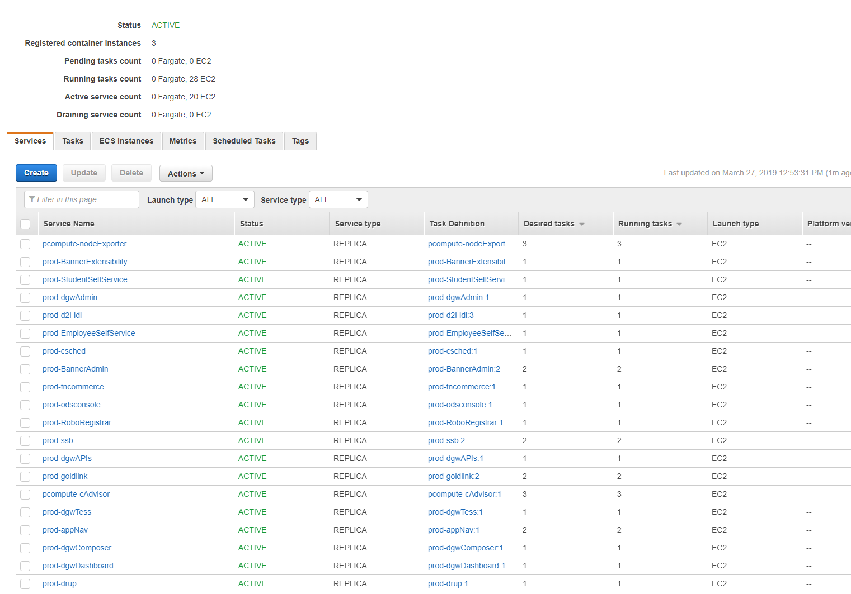
Architecture

Slide 9
Technologies and Services
Docker

Slide 10
Technologies and Services
Docker

Slide 11
Technologies and Services
ECS Compute Cluster
Git & ECS Configs

Slide 12
Technologies and Services
ECS Compute Cluster
Git & ECS Configs

Slide 13
Technologies and Services
Terraform
resource "aws_instance" " dban" {
ami = "ami-ae7bfdb8"
instance_type = "m4.xlarge"
subnet_id = "${module.vpc.private_subnets[1]}"
key_name = "linux_banner_key"
private_ip = “xxx.xx.xx.xxx"
vpc_security_group_ids = ["${aws_security_group.dban.id}"]
root_block_device{
volume_type = "gp2"
volume_size = "100"
delete_on_termination = "false"
}
}

Slide 14
Technologies and Services
Terraform
resource "aws_ecs_service" "prod-BannerAdmin" {
name = "prod-BannerAdmin"
cluster = "${aws_ecs_cluster.pcompute.id}"
task_definition = "${aws_ecs_task_definition.prod-BannerAdmin.arn}"
desired_count = 2
iam_role = "${aws_iam_role.pecs_service_role.arn}"
depends_on = ["aws_iam_role_policy.pecs_service_role_policy"]
load_balancer {
target_group_arn = "${aws_alb_target_group.prod-BannerAdmin.arn}"
container_name = "prod-BannerAdmin",
container_port = 8080
}
…..
}

Slide 15
Technologies and Services
Terraform

Slide 16
Technologies and Services
Lambda
rave-rss c2g campustoursmaint ec2-start-parkable errors-remedy-to-slack SecureAccess_ETL pobox-sync pwebsql1-ip-check ebs-backup-worker contracts_etlemailer trs-etl wets sa-log-clean campus_tours_emailer compcalc_etl major-change contact_methods_etl snsToSlack provost_etl ebs-backup-prune ec2-stop-parkable TRS_Reminders parking

Slide 17
Technologies and Services
AMIs and Snapshots
Snap AMIs quarterly or major upgrades
Snap AMIs for install baselines
Snapshots nightly
Automated Backup and Prune via Lambda
Migrate to Amazon Data Lifecycle Manager

Slide 18
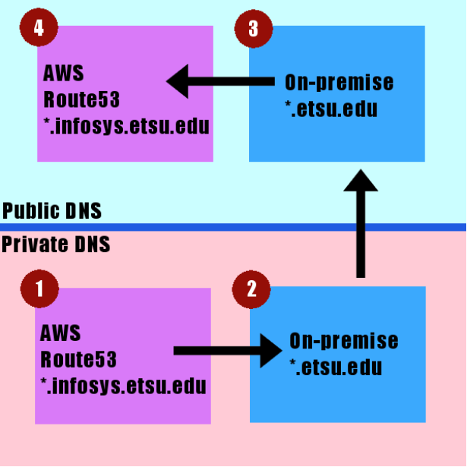
Technologies and Services
Route 53 and DNS forwarders
Legacy domains
Point on-prem DNS entry to APEX load balancer
goldlink.etsu.edu
degreeworks.etsu.edu

Slide 19
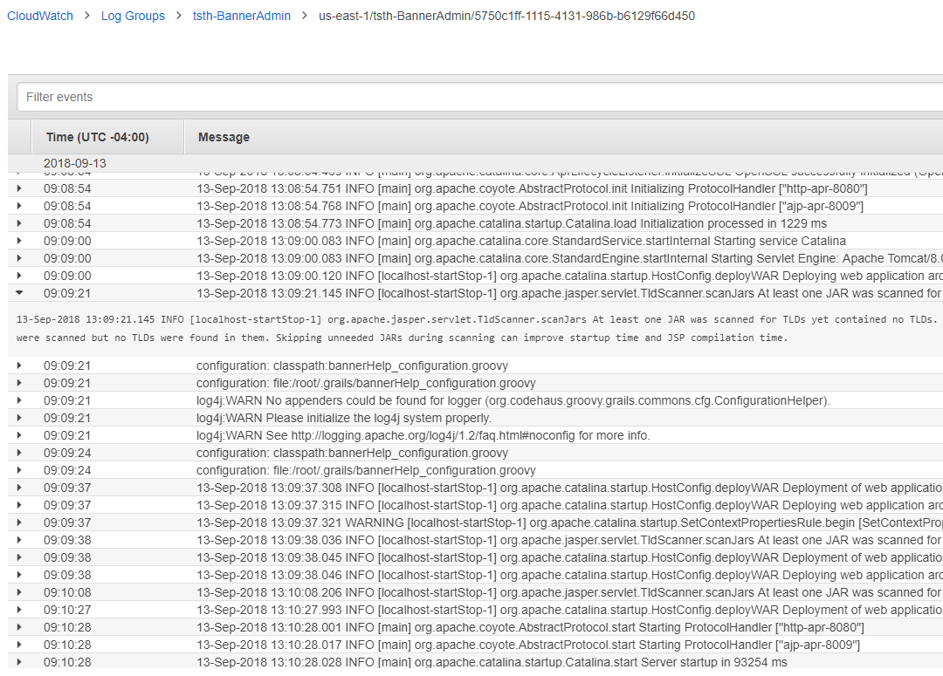
Technologies and Services
Logging
Cloudwatch
Cloudtrail (Audit)
S3 Log Dumps

Slide 20
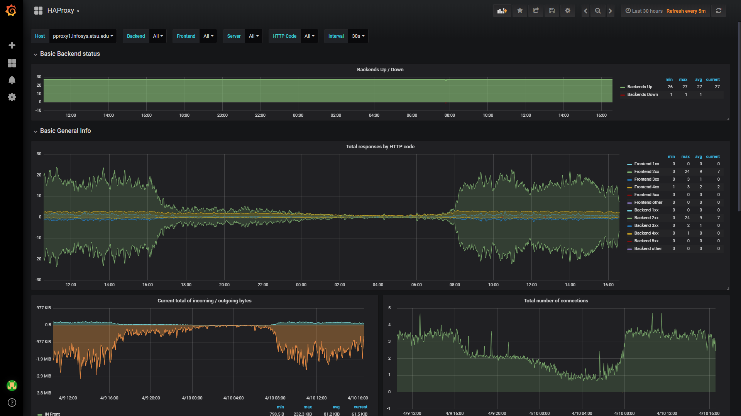
Technologies and Services
Monitoring
Prometheus
Alerts Manager
Slack
Grafana

Slide 21
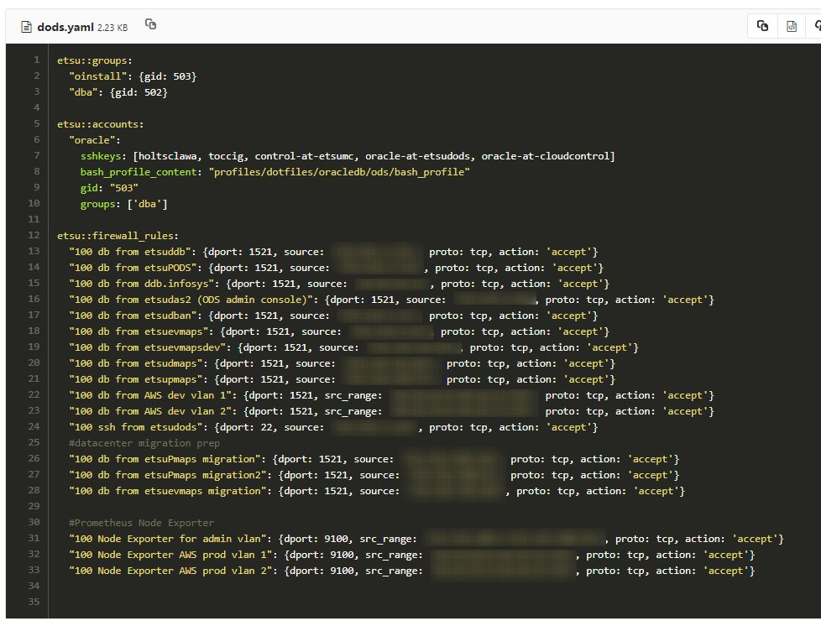
Technologies and Services
Configuration Management

Slide 22
Benefits
Better Disaster Recovery
AMIs, Snapshots, Infrastructure as Code
High Availability
Multi-AZ, Multiple Instances, Load Balanced
Improved Scalability
ECS Compute Clusters, Auto-Scaling Groups, Containers. Capacity on Demand
Improved Security
Network Isolation, Security Groups, Monitoring, VPN Gateway, Peering
Easier to Maintain
Declarative Infrastructure and Services. Git / Continuous Integration Pipelines

Slide 23
Challenges
Timing
Staffing (workload/capacity and self-learning)
Cost (Op-ex vs Cap-ex)
AWS Contract
Networking (VPN Gateway, CISCO ASA, SQL Fixup protocol, persistent connection sniping)

Slide 24
What’s Next?
Containerize more apps
Puppetize more vm configuration
Create standby in separate region
Increase usage of CI/CD
Increase monitoring via Prometheus and smart alerting
Greenfield
AWS Fargate
Kubernetes

Slide 25
Albert ‘Alby’ Holtsclaw Senior Database Administrator / Senior DevOps Architect
AlbertHoltsclaw.com holtsclawa@etsu.edu

